Slide 1
Data modeling in Key Value and Document Stores
Philipp Fehre | Developer Advocate, Couchbase

Slide 2



Notes:
Some history
Ask who is familiar with what

Slide 3
Couchbase on 1 slide
Key Value
Document database
Cache
Performance

Slide 4
Why choose something other then Relational?

Slide 5
Relational is really good!
Proven in production
Well understood performance characteristics
Developers know the stumbling blocks
Easy to grasp model
Notes:
Facebook has been using MySQL for year, and so have millions others
Performance can be suboptimal, but people know how to optimize it
Transactions make code easy to follow

Slide 6
Why relational can be hard
Sharding breaks the model
Scaling is very manual
Hitting the speed ceiling
External caches
Notes:
Sharding does not mix well with transactions or denormalization
Building a MySQL or Postgresql cluster is manual without much support from the database
There is a certain amount of overhead associated with running a query, which is always there
Most likely you are running a combination of MySQL + Memcached

Slide 7
Key Value Stores
Notes:
Think: Riak, Couchbase, Memcached, Membase (Couchbase), Hazelcast

Slide 8
Operations
SET key, value
SET “a”, “some value” # => true
GET key
GET “a” # => “some value”
DELETE key
DELETE “a” # => true
Notes:
Basic CRUD
Really simple

Slide 9
ADD key, value
ADD “b”, “something else” # => true
ADD “b”, “something else” # => false
REPLACE key, value
REPLACE “b”, “foo” # => true
REPLACE “not a key”, “foo” # => true
And more …
Notes:
- Just to complete the set here

Slide 10
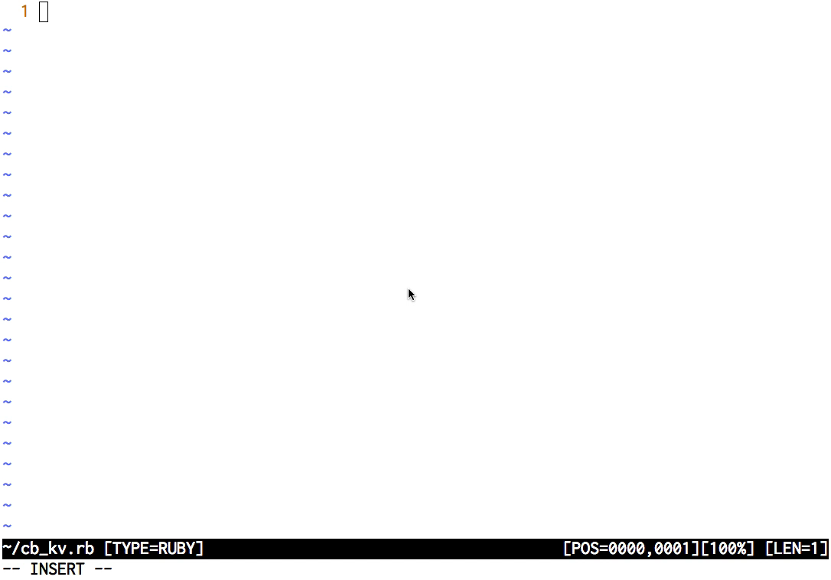
Using Couchbase as a Key Value store

Slide 11
Why so simple?
Very easy to distribute
Very fast
Simple core model
Notes:
No interdependencies in the keys
You can transform the keys whatever way you like as long as it is reversable!
No Query parser, no analyzing what is happening just get the key!
Has been the model for caches for decades

Slide 12
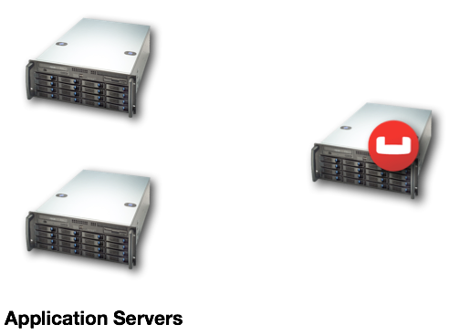
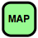

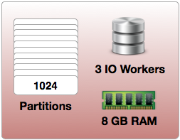
Fast
Hash(“my_key!”) → Partition[0..1023] {25}
ClusterMap[P(25)] → [x.x.x.x]
x.x.x.x → Server Responsible for Partition 25

Slide 13
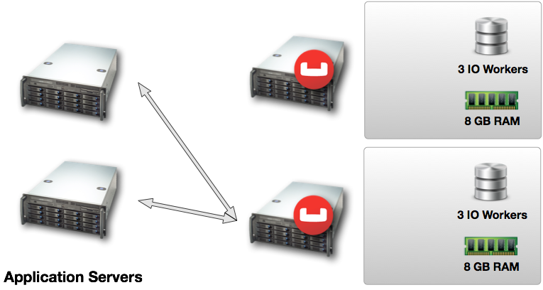
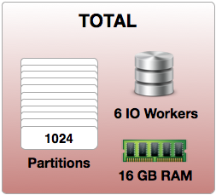

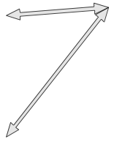
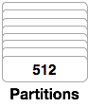
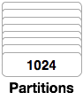
Distribute

Slide 14
Oh so simple…
No advanced queries
Hard to make all data fit a Key Value model
How can I query a range of keys?
range:1
{
values: [ key1, key2, key3 ],
next: range:2
}
Notes:
If you haven’t defined it in a Key you ain’t gonna get it
Sometimes we don’t want to invest the time to model everything as Key Value, it might not be worth it
Ranges can be modeled as value being a list and then query them individually

Slide 15
Everything can be modeled as key value, but its not always easy!

Slide 16

Think Memcached
This model has been the core to many applications for years

Slide 17
Document Stores
Notes:
- You know them: MongoDB, CouchDB, Couchbase are the most prominent I guess

Slide 18
… a Key Value Store ++
Advanced query support
Ability to tradeoff speed for easier modeling when appropriate
Easy to distribute
Notes:
2nd indexes allow for some advanced queries, and depending on your database they can be very advanced
Support for range queries
Operational unit is 1 document this allow for easy distribution

Slide 19
But a key value store after all…
Maximum speed is only for Key Value
Operations on one and only document
Seemingly easy model which can grow really complex
Notes:
Growing 2nd indexes can be a pain
When we need the speed we need to go back to KV…
This can be good because after all we can at least!

Slide 20
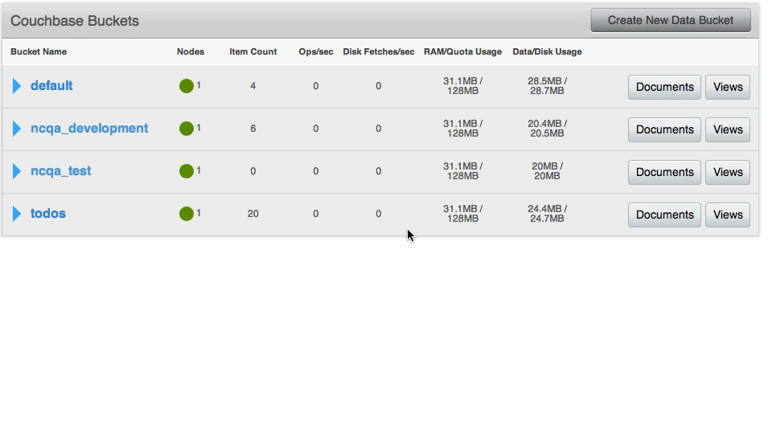
Indices inside documents
Notes:
- Couchbase Views example

Slide 21
Data Modeling

Slide 22
Advantages of modeling as JSON
public class User {
private String name;
private String email;
private Integer age;
private Boolean gender_male;
private DateTime created_at;
private ArrayList items_viewed;
private Hashtable preferences;
private ArrayList<Books> authored;
public User(...) {
...
}
...
}

Slide 23
JSON
{
"doctype": “user",
"name": ”Philipp",
"email": ”philipp@couchbase.com",
"age": 30,
"gender_male": true,
"created_at": "2014-09-20 23:59:59",
"items_viewed": [
"12345",
"23456",
"23457”
],
"preferences": {
"email_notifications": true,
"sms_notifications": false
},
"authored": [
{ "title": "Couchbase Models”, "price": 49.95 }
]
}

Slide 24
What to think about
Key Value is always going to be fastest
Optimize for fast access where needed
Optimize for convenience where possible

Slide 25
Data Modeling Patterns
For Key Value

Slide 26


Referential Keys
Data Creation
add("u::550e8400", data)
add(”philipp@couchbase.com", "u::550e8400")
Application
add(”ischi", "u::550e8400")
Data Retrieval
key = get(”philipp@couchbase.com")
get(key)
Application

Slide 27
Counter ID
Data Creation
id = incr(“my-counter")
add("key" + id, data)
Application
Iterate Through Collection
count = get(”my-counter")
multi-get(keys[])
Application

Slide 28
Combine all the things
Data Creation
id = incr("user::count")
add("u::" + id, data)
add(”philipp@couchbase.com", id)
Application
add(”ischi", id)
Data Retrieval
key = get(”philipp@couchbase.com")
get(key)

Slide 29
In Action
user::1
{
name: “Jasdeep”,
points: 1000,
shopping_carts: [
1000, 1001, 1002
],
products_bought: [
2000, 2001, 2002
],
games_won: [
3000, 3001, 3002, 3004
],
notifications: [
“Hi Bob”, “Happy Hour?”,
]
}
user::1
{ name: “Jasdeep” }
user::1::points
{ points: 1000 }
user::1::shopping_carts
{ carts: [ 1000, 1001, 1002 ],
products_bought: [ 2000, 2001, 2002] }
user::1::games_won
{ game_ids: [ 3000, 3001, 3002, 3004] }
user::1::notification_count
57
user::1::notifications::57
{ message: “Hi Bob” }
user::1::notifications::56
{ message: “Happy Hour?” }

Slide 30
The real world

Slide 31
A Product catalog - Requirements
We have a fixed stock of any given item
We need to store a variable number of images
Images are loaded in batches
We handle use upload of images
Products have names we want to be able to search

Slide 32
A Product catalog
Stock needs to be consistent, use a atomic counter
Images need to be retrieved in batches fits counter id pattern
Users upload a variable number of images, so use a counter id pattern
We need to search, use a Index

Slide 33
The Model
prod:101
{ name: “my-product”,
type: “product”,
description: “a thing”, …}
prod:101:image_counter
1
prod:101:image:1
http://cdn.for.my.image/image_id
prod:101:stock
5

Slide 34
Search
function (doc, meta) {
if(doc.type === “product”) {
emit(doc.name)
}
}

Slide 35
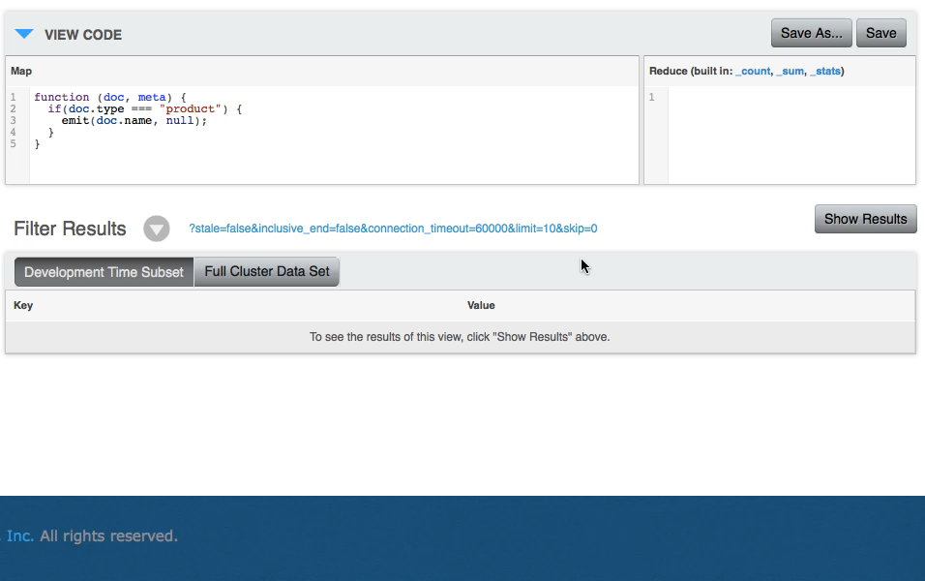
Search

Slide 36
Want more?
Hook into more specialized systems
Hadoop
Elasticsearch
polyglot persistence

Slide 37
Leverage different systems for what they are good at!

Slide 38
Thank you!
Philipp Fehre
Twitter: ischi
Github: sideshowcoder
Email: philipp@couchbase.com

